Slide 1

ASCENT
Series A Pitch Deck · Fueling Exponential Growth

Slide 2
The Problem
Teams waste 10+ hours/week on manual, disconnected workflows
Existing tools are fragmented, expensive, and hard to scale
Lack of real-time visibility slows decision-making
SMBs are underserved by enterprise-grade solutions

Slide 3
Our Solution
Unified platform that automates the entire workflow end-to-end
Real-time analytics and insights in one dashboard
Seamless integrations with existing tools
Built to scale from startup to enterprise

Slide 4

Product Demo
Intuitive dashboard, real-time insights, seamless onboarding

Slide 5
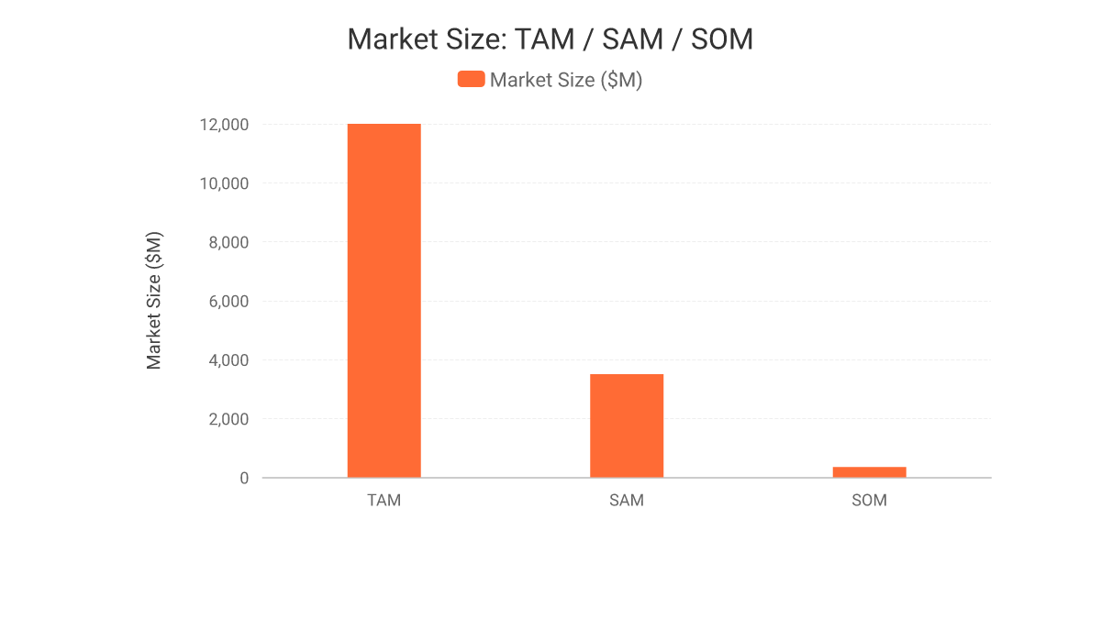
Market Size
$12.0B Total Addressable Market
$3.5B Serviceable Addressable Market
$350M Serviceable Obtainable Market (Yr 1)

Slide 6
Business Model
Tiered SaaS subscriptions: Starter, Growth, Enterprise
Usage-based add-ons for high-volume customers
Annual contracts drive 92% net revenue retention
Land-and-expand motion across departments

Slide 7
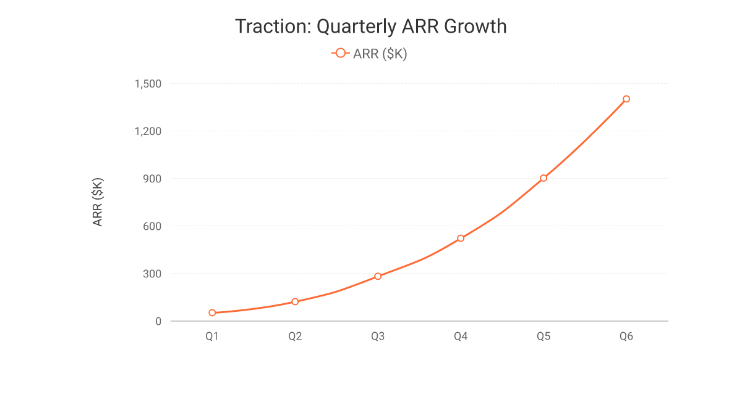
Traction
28x ARR growth across 6 quarters
$1.4M ARR as of Q6
Consistent quarter-over-quarter acceleration

Slide 8
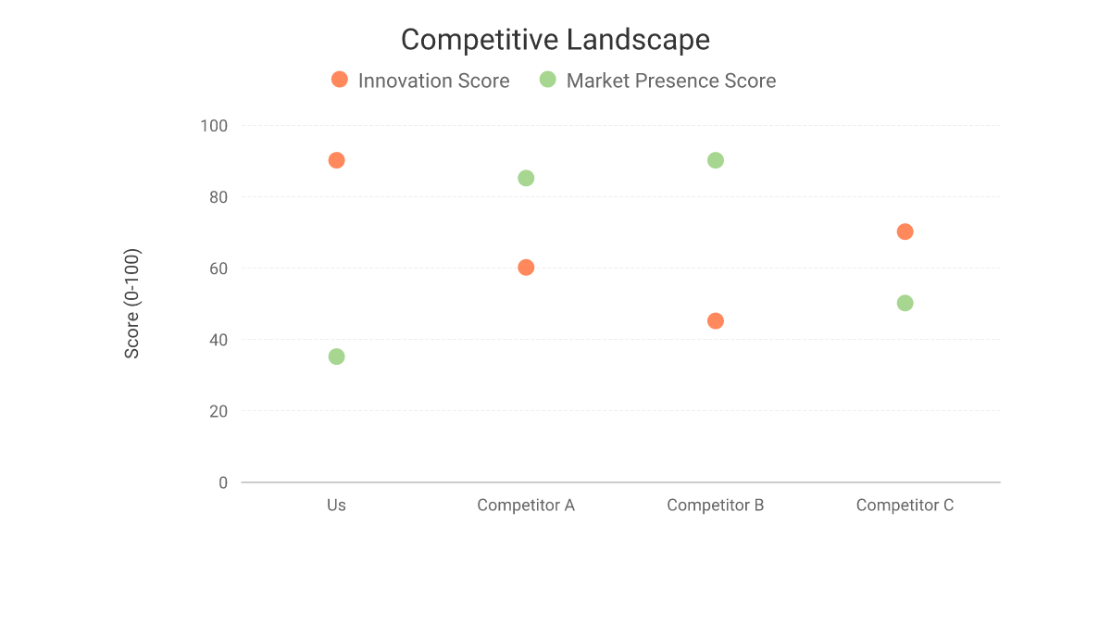
Competitive Landscape
Highest innovation score in the category
Focused entry, rapidly expanding market presence
Clear differentiation versus legacy incumbents

Slide 9
Go-to-Market Strategy
Product-led growth with self-serve onboarding
Outbound sales targeting mid-market accounts
Strategic partnerships and channel resellers
Content and community-led demand generation

Slide 10
Our Team
Jordan Lee — CEO & Co-Founder, ex-Scale-up Operator
Priya Nair — CTO & Co-Founder, ex-Big Tech Engineering Lead
Sam Carter — Head of Growth, 2x Startup GTM Leader
Maria Gomez — Head of Product, Design & UX Veteran

Slide 11
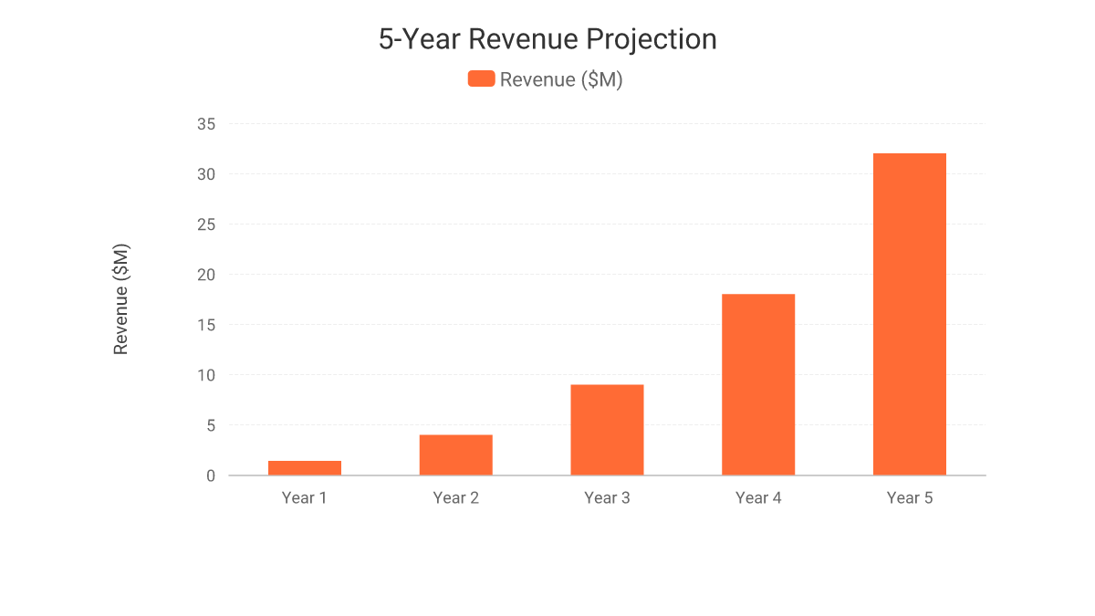
Financial Projections
$32M projected revenue by Year 5
22.9x revenue growth over 5 years
Path to profitability by Year 3

Slide 12
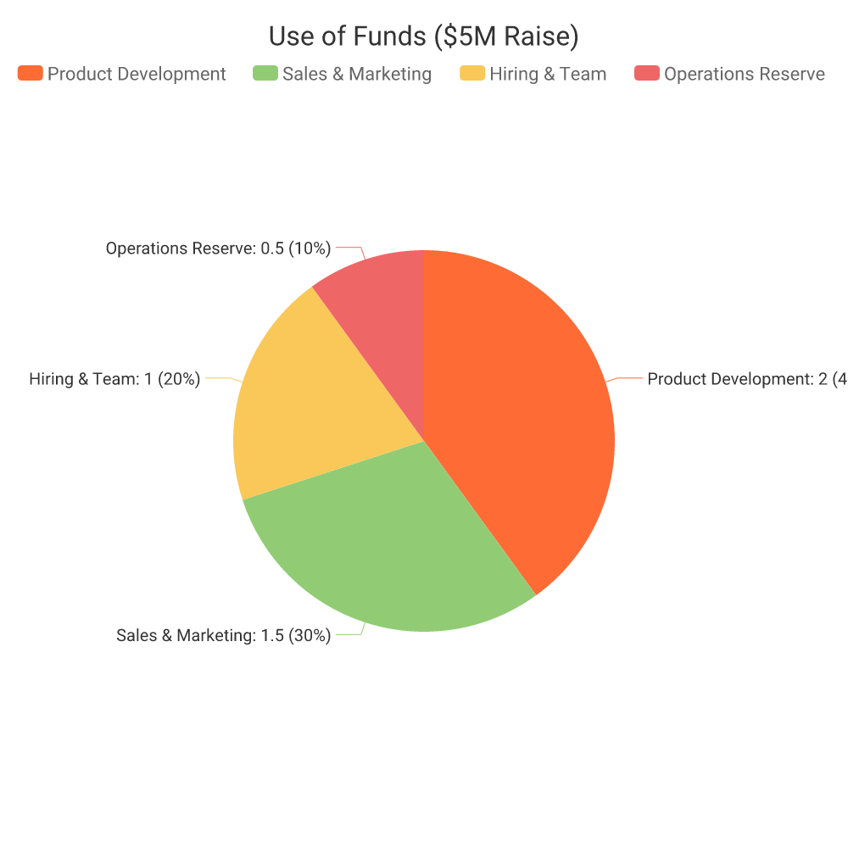
Use of Funds
40% Product Development
30% Sales & Marketing
20% Hiring & Team

Slide 13
The Ask
$5M Series A raise
$20M pre-money valuation ($25M post-money)
20% equity offered
18-month runway to Series B

Slide 14
Roadmap
Q1 2025: Launch v2 platform
Q2 2025: Enterprise tier launch
Q4 2025: EU market expansion
Q2 2026: Series B readiness

Slide 15
Let's Build the Future Together
hello@ascent.io · ascent.io

