Slide 1
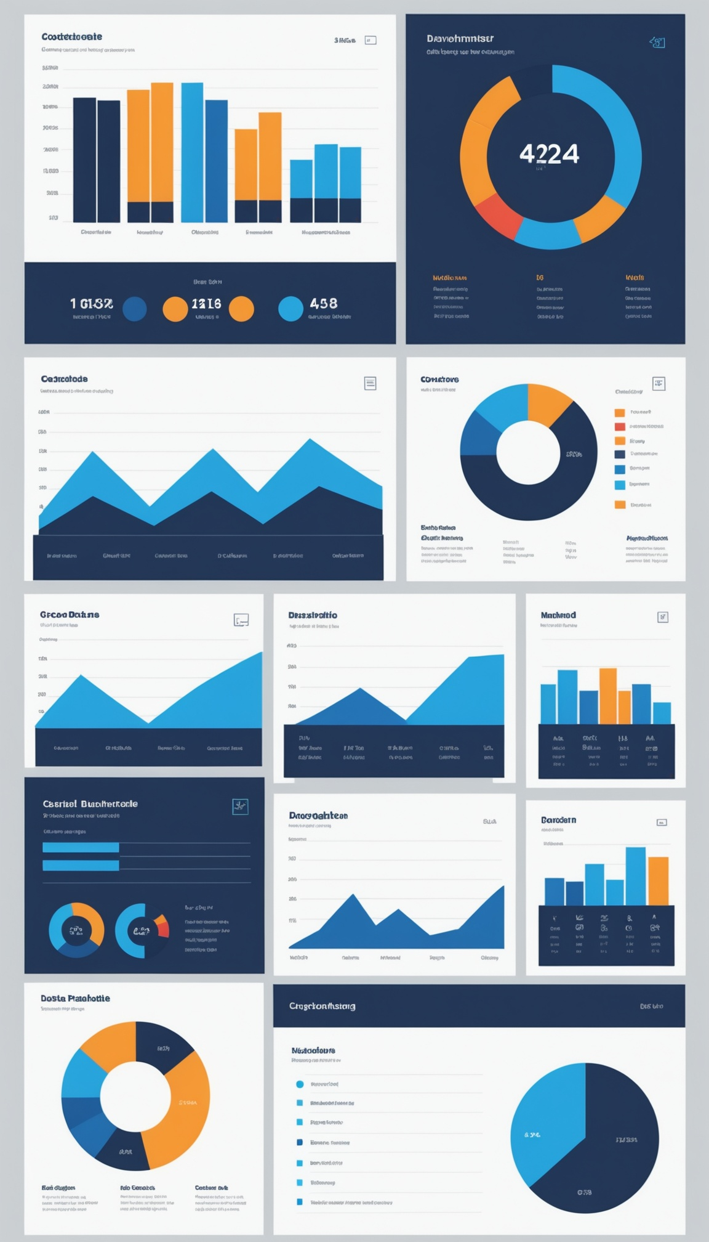
QUARTERLY REVIEW DECK
Performance, KPIs & Strategic Outlook

Slide 2
Agenda
Quarter highlights and revenue overview
KPI dashboard and OKR tracking
Team and department updates
Challenges, wins, and next quarter priorities

Slide 3
Quarter Highlights
Total revenue of $1,385K, 6.5% above the $1,300K target
Customer retention held strong at 92%
NPS score reached 45, trending toward goal
Product X launched successfully on schedule

Slide 4
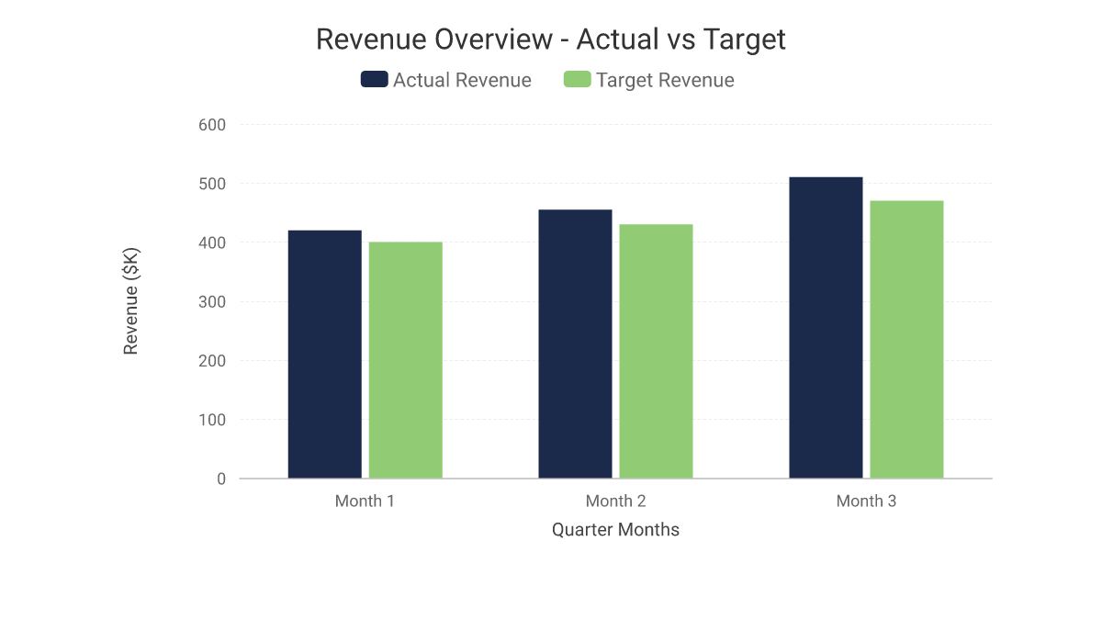
Revenue Overview
Actual revenue outpaced target every month
Q close: $1,385K actual vs $1,300K target
Strongest month-over-month growth in Month 3

Slide 5
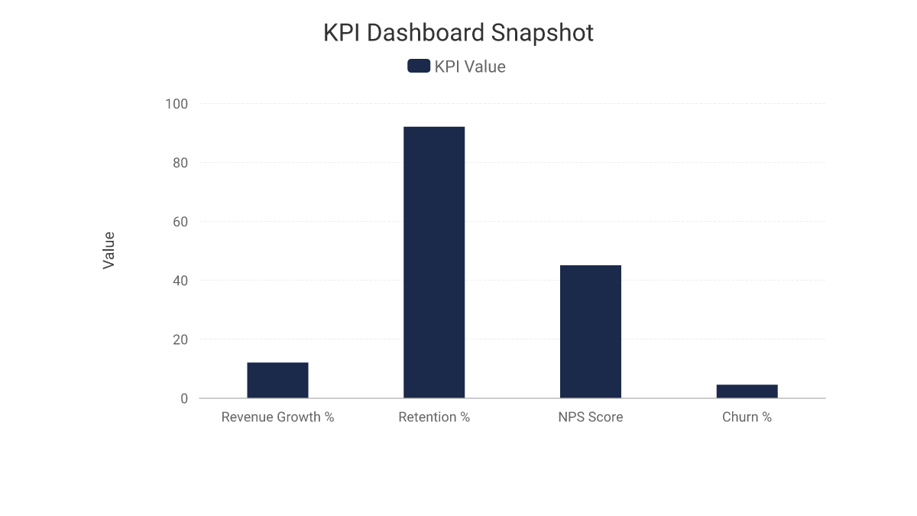
KPI Dashboard
Revenue growth: 12% quarter-over-quarter
Customer retention: 92%, NPS: 45
Churn rate: 4.5%, slightly above goal

Slide 6
Team Highlights
Headcount grew 8% across engineering and sales
Employee engagement score up to 87%
Two internal promotions to leadership roles
Cross-functional collaboration initiative launched

Slide 7
OKR Tracking
ARR Growth: Target 15% -> Actual 12%
Product X Launch: Completed on schedule
NPS Score: Target 50 -> Actual 45
Churn Rate: Target 3% -> Actual 4.5%

Slide 8
Department Update: Sales
Closed $1,385K in quarterly revenue, 6.5% above target
Win rate improved to 34%, up from 29%
Pipeline coverage now at 3.2x quota
New enterprise logo count: 5

Slide 9
Department Update: Marketing
Generated 1,240 qualified leads, up 18%
Brand campaign drove 22% increase in site traffic
Cost per lead reduced by 11%
Launched two new case study assets

Slide 10
Department Update: Engineering
Shipped Product X on schedule with zero critical bugs
Reduced average deployment time by 30%
Improved platform uptime to 99.9%
Completed migration to new infrastructure stack

Slide 11
Challenges & Blockers
Churn rate at 4.5%, above the 3% target
NPS still trailing the 50-point goal
Hiring pipeline for senior engineers remains tight
Cross-team dependencies delayed one integration

Slide 12
Wins & Case Studies
Enterprise client expanded contract by 40%
Product X launch praised in customer feedback
Marketing case study drove a top-tier inbound deal
Support team achieved 95% satisfaction score

Slide 13
Next Quarter Priorities
Reduce churn to below 3% through retention program
Push NPS above 50 with product experience updates
Scale enterprise sales motion and pipeline coverage
Accelerate senior engineering hiring plan

Slide 14
Let's carry this momentum into next quarter.
questions@company.com

