Slide 1

SALES KICKOFF 2026
Ignite. Elevate. Dominate.

Slide 2
2025: Year in Review
$98M in revenue closed — a strong foundation
340 new logos won across all regions
94% customer retention rate
22% year-over-year growth

Slide 3
2026 Vision & Theme
Ignite. Elevate. Dominate. — Our mission for 2026 is to launch faster, close bigger, and lead the market.

Slide 4
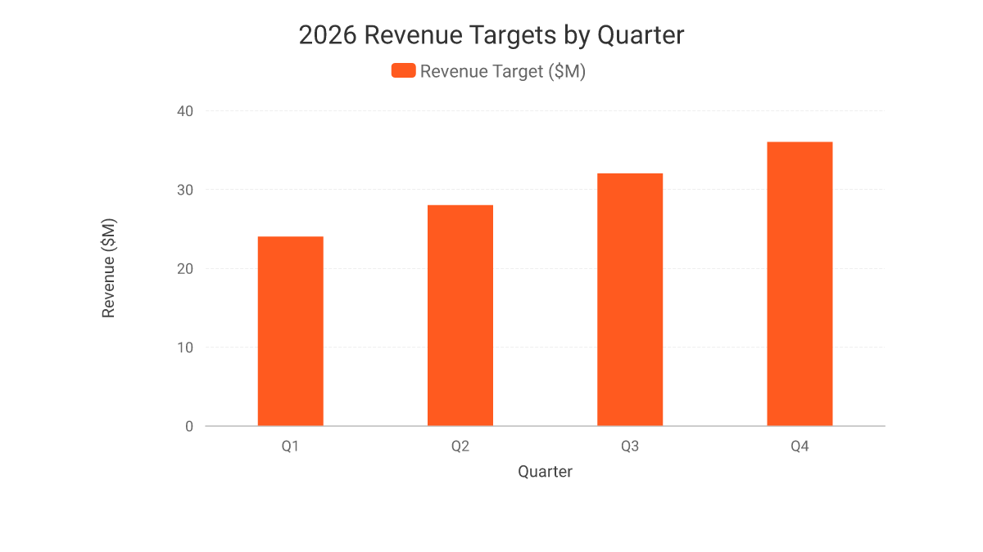
2026 Revenue Targets
Q1: $24M | Q2: $28M | Q3: $32M
Q4: $36M to close the year strong
Total 2026 target: $120M

Slide 5
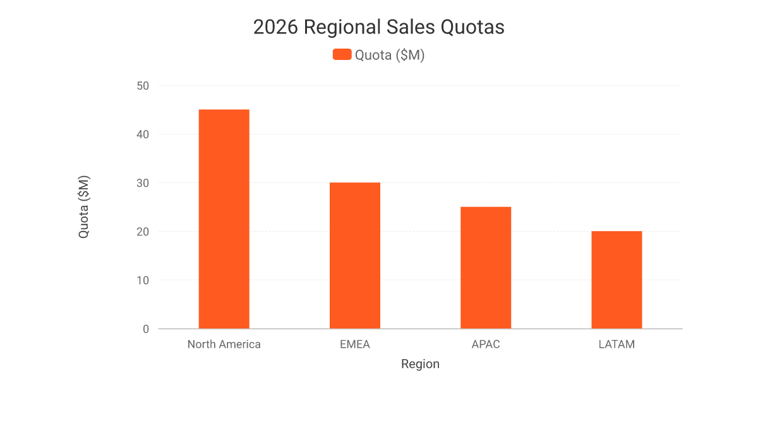
2026 Regional Quotas
North America: $45M | EMEA: $30M
APAC: $25M | LATAM: $20M
Every region fuels the $120M mission

Slide 6
New Product Highlights
Velocity Suite — faster deal cycles, built for speed
Momentum AI — predictive insights that close deals
Apex Mobile — sell from anywhere, anytime
All three launch company-wide in Q1 2026

Slide 7
Incentive & Comp Plan Overview
Base + uncapped commission
Accelerators at 100% / 125% / 150% quota
President's Club trip for top 10%
Spot bonuses for early quota attainment

Slide 8
Top Performer Recognition
187%
Jordan Lee closed $4.2M — 187% of quota attainment in 2025

Slide 9
Sales Playbook Summary
MEDDIC qualification framework, every deal
Discovery to Demo to Close cadence
Objection-handling scripts refreshed for 2026
Playbook lives in Salesforce for quick access

Slide 10
Tools & Enablement
Salesforce CRM — single source of truth
Gong call intelligence for coaching at scale
New battlecards for every competitor
Sales Enablement Academy for onboarding

Slide 11
Team Rally
One team. One target. Let's launch 2026 like a rocket and land every quota.

Slide 12
Questions? Let's talk.
sales-enablement@company.com

