Slide 1

CYBERSECURITY TRAINING
Enterprise Onboarding Program

Slide 2
Training Agenda
Threat landscape and why security matters
Core policies: passwords, MFA, devices, data
Incident reporting and physical/remote security
Knowledge check and key resources

Slide 3
Why Security Matters
Breaches cost time, money, and trust
Every employee is a frontline defender
Compliance and legal obligations apply to all
Small mistakes can cause major incidents

Slide 4
Common Threats Overview
Phishing: deceptive emails or messages steal credentials
Malware: malicious software damages or spies on systems
Social engineering: manipulation tricks people, not systems
Threats often combine multiple tactics together

Slide 5
Phishing Example Walkthrough
Urgent tone pressures quick, unchecked action
Sender address looks similar but is spoofed
Suspicious links hide malicious destinations
Always verify before clicking or replying

Slide 6
Password Best Practices
Use unique passphrases of 14+ characters
Never reuse passwords across accounts
Store credentials only in approved password managers
Change passwords immediately after any suspected exposure

Slide 7
MFA Setup Guide
Step 1: Install an approved authenticator app
Step 2: Scan the QR code from account settings
Step 3: Enter the generated verification code
Step 4: Save backup codes in a secure location

Slide 8
Device Security Policy
Enable full-disk encryption on all devices
Lock screens automatically after 5 minutes idle
Install updates and patches promptly
Only use company-approved software and hardware

Slide 9
Data Handling Guidelines
Classify data before storing or sharing it
Encrypt sensitive data in transit and at rest
Share data only on a need-to-know basis
Dispose of data securely when no longer needed

Slide 10
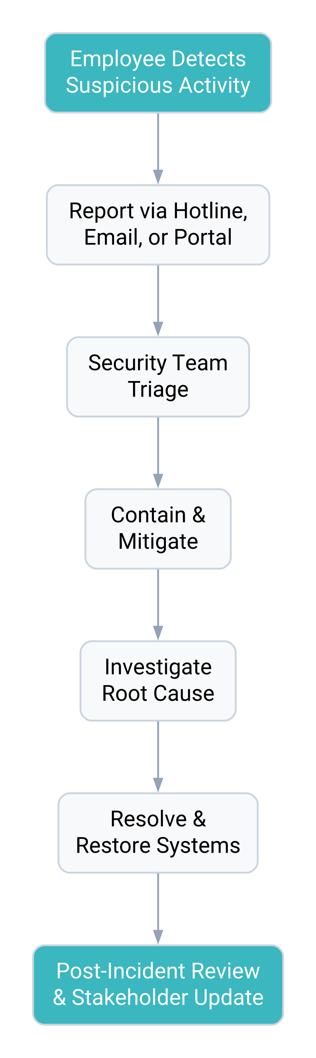
Incident Reporting Process
Report suspected incidents immediately, never wait
Security team triages and contains within hours
Every incident closes with a review and lessons learned

Slide 11
Physical Security
Badge in and never let others tailgate
Lock devices and desks when unattended
Escort visitors at all times on-site
Shred sensitive documents, don't bin them

Slide 12
Remote Work Security
Connect only through the approved VPN
Secure your home network with strong encryption
Avoid public Wi-Fi for sensitive work
Keep work devices separate from personal use

Slide 13
Quiz / Knowledge Check
What are 3 signs of a phishing email?
Why does MFA matter even with strong passwords?
Who do you contact to report an incident?
True or false: public Wi-Fi is safe for work?

Slide 14
Do's and Don'ts Summary
Verify links before clicking
Use MFA on every account
Report incidents immediately
Reuse passwords across sites
Leave devices unlocked
Share data without verification

Slide 15
Resources & Contacts
IT Security Helpdesk: security@company.com
24/7 Incident Hotline: +61 1800 000 000
Security Portal: internal policy and training hub
Report suspicious activity anytime, no penalty for asking

Slide 16
Stay Alert. Stay Secure.
security@company.com | Internal Security Portal

