Slide 1
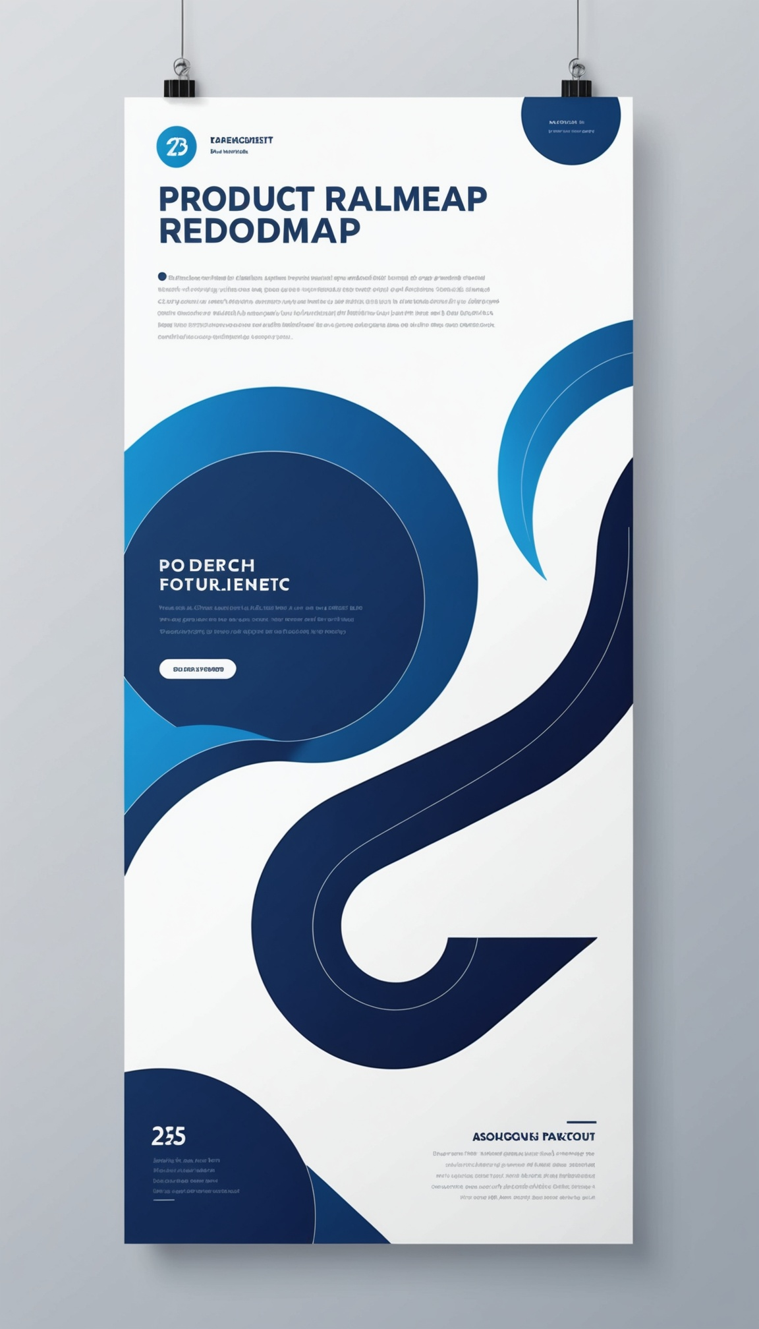
PRODUCT ROADMAP VISUALS
FY2025 Product Strategy & Timeline

Slide 2
Roadmap Overview & Themes
Customer-centric growth across the core platform
Scalability, reliability & performance investments
AI-powered features expanding user value
Ecosystem integrations & partner enablement

Slide 3
Now / Next / Later Framework
Now: Stabilize core platform & close critical gaps
Next: Launch AI-assisted workflows & integrations
Later: Explore adjacent markets & open platform APIs

Slide 4
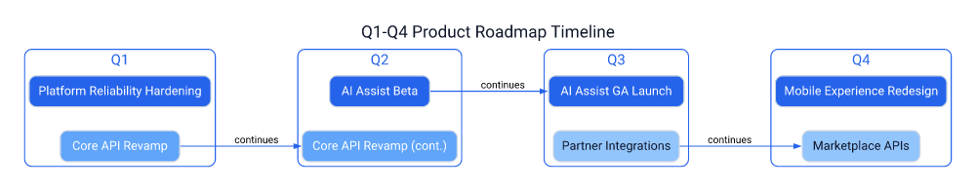
Q1-Q4 Timeline
Core API Revamp spans Q1-Q2, unlocking AI features
AI Assist moves Beta (Q2) to GA (Q3)
Mobile & Marketplace APIs close out Q4

Slide 5
Feature Release Highlights
Q1: Reliability hardening + API foundations
Q2: AI Assist Beta launches to select users
Q3: AI Assist GA + partner integrations live
Q4: Mobile redesign + marketplace APIs ship

Slide 6
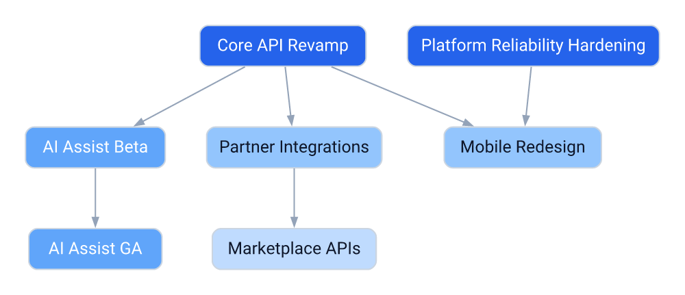
Dependencies Map
Core API Revamp is the critical-path dependency
Mobile Redesign depends on Reliability + API work
Marketplace APIs depend on Partner Integrations

Slide 7
Stakeholder Impact
Engineering: New API contracts & tooling
Sales: Updated pricing & packaging
Support: Training on new AI features
Customers: Faster performance & new AI tools
Partners: New integration endpoints
Investors: Clear growth narrative & KPIs

Slide 8
Success Metrics
Platform uptime of at least 99.9% by Q2
AI Assist adoption: 25% of active users by Q3
15 live partner integrations by Q4
NPS improvement: +10 points year-over-year

Slide 9
Risks & Mitigations
API migration delays
AI feature accuracy concerns
Partner onboarding bottlenecks
Phased rollout with fallback plan
Human-in-loop review & feedback loops
Dedicated partner enablement team

Slide 10
Let's build the roadmap together.
roadmap@productteam.com

