Slide 1
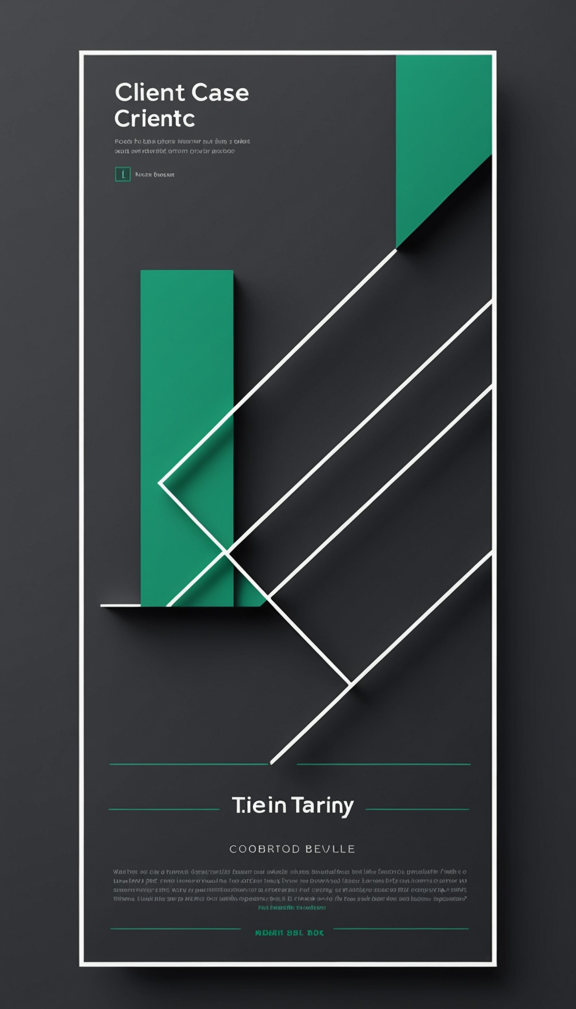
CLIENT CASE STUDY
How Meridian Retail Co. grew revenue 62% in 6 months

Slide 2
Client Background
Meridian Retail Co. — E-commerce & Retail sector
Multi-channel retailer with a growing online customer base
Relied on legacy, disconnected systems for years
Sought a partner to modernize operations at scale

Slide 3
The Problem
Declining online conversion rates quarter over quarter
Slow, error-prone order fulfillment process
Rising customer churn tied to poor experience
Legacy systems couldn't scale with demand

Slide 4
The Solution & Approach
Deployed an AI-driven personalization engine
Implemented supply chain optimization platform
Phased rollout to minimize business disruption
Dedicated success team for hands-on support

Slide 5
Implementation Timeline
Month 1: Discovery & Systems Audit
Month 2-3: Platform Integration & Data Migration
Month 4: Pilot Rollout to Key Markets
Month 5-6: Full-Scale Launch & Optimization

Slide 6
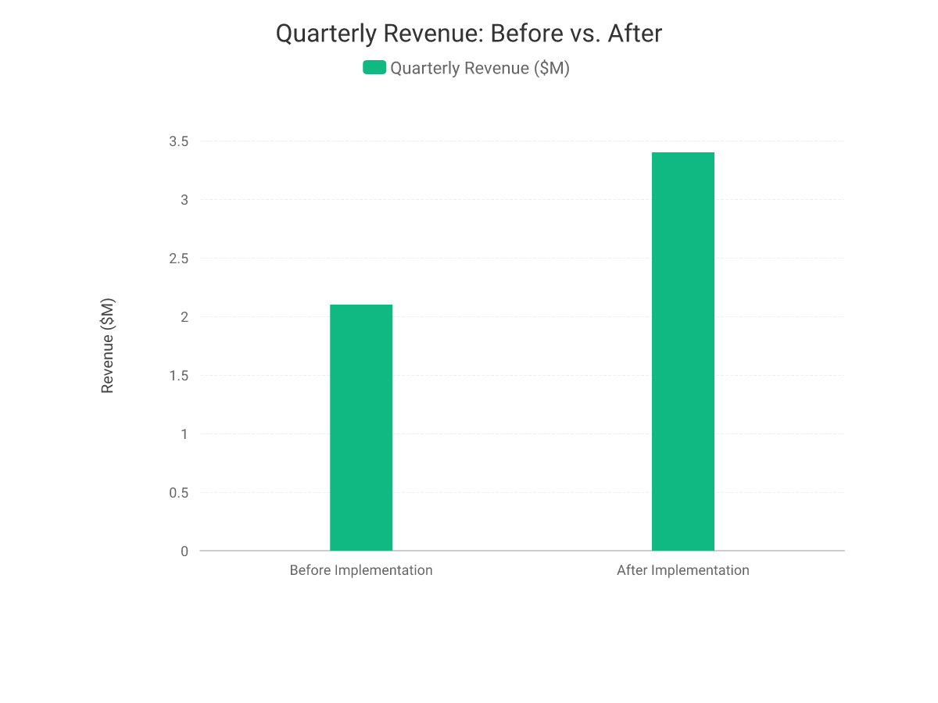
Results & Impact
Quarterly revenue grew from $2.1M to $3.4M
That's a 62% revenue increase in 6 months
Customer satisfaction rose from 72 to 91 (+26%)

Slide 7
Key Metrics
ROI: 320%
Investment: $200K
Net Benefit: $640K
Revenue Growth: 62%
CSAT Score: 72 → 91 (+26%)
Support Tickets: -45%

Slide 8
Client Testimonial
"This partnership transformed how we operate — revenue grew 62% in just six months, and our team finally has the tools to scale with confidence." — Sarah Chen, VP of Operations, Me

Slide 9
Ready to write your own success story?
hello@ourcompany.com

